Slide 1
DATABASE NORMALIZATION
Created By
Shakir khan
Niit Vellore Officersline
Vellore

Slide 2
Definition of Normalization
Is a method of breaking down complex table structures into simple table structures by using certain rules to reduces redundancy and dependency of data.
It divides larger tables to smaller tables and links them using relationships.
Has the following benefits:
It helps in maintaining data integrity.
It helps in simplifying the structure of tables.
It helps in reducing the null values, which reduces the complexity of data operations.
Some rules that should be followed to achieve a good database design are:
Each table should have an Unique Column.
Each table should store data for a single type of entity.
Columns that accept NULLs should be avoided.
The repetition of values or columns should be avoided.

Slide 3
Types of Normalization Forms
First Normal Form (1NF)
Second Normal Form (2NF)
Third Normal Form (3NF)
Boyce-Codd Normal Form (BCNF)

Slide 4
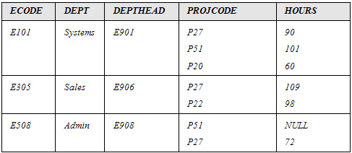
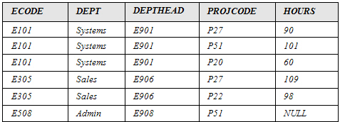
First Normal Form
Rules
Each table cell should contain a single value.
Each record needs to be unique.
Eliminate duplicative columns from the same table.
Create separate tables for each group of related data and
identify each row with a unique column or set of columns
PROJECT table is not in first normal form because cells in PROJCODE and HOURS have more than one value.
Primary key
After 1st Normalization
Before 1st Normalization

Slide 5
Before we proceed let's understand a few things --
WHAT IS A KEY?
A KEY is a value used to identify a record in a table uniquely. A KEY could be a single column or combination of multiple columns
Note: Columns in a table that are NOT used to identify a record uniquely are called non-key columns.
WHAT IS A PRIMARY KEY?
A primary is a single column value used to identify a database record uniquely.
It has following attributes
A primary key cannot be NULL
A primary key value must be unique
The primary key values should rarely be changed
WHAT IS COMPOSITE KEY?
A composite key is a primary key composed of multiple columns used to identify a record uniquely
WHAT IS FOREIGN KEY ?
Foreign Key references the primary key of another Table! It helps connect your Tables
A foreign key can have a different name from its primary key
It ensures rows in one table have corresponding rows in another
Foreign keys can be null even though primary keys can not

Slide 6
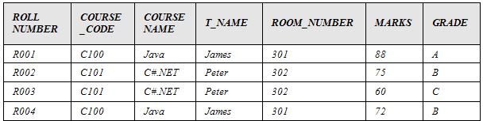
Functional dependency:
Primary key
To convert the table to 2NF, We must first
understand the concept of functional dependency.
Functional dependency:
Attribute A is functionally dependent on B if and
only if, for each value of B, there is exactly one value of A.
Attribute B is called the determinant.
Explanation:
For a particular value of ROLL_NUMBER+COURSE_CODE, there is precisely one corresponding value for MARKS.
Hence, MARKS is functionally dependent on ROLL_NUMBER+COURSE_CODE.
COURSE_CODE→COURSE_NAME
COURSE_CODE→T_NAME (Assuming one course is taught by only one teacher.)
T_NAME→ROOM_NUMBER (Assuming each teacher has his/her own, unshared room.)
MARKS→GRADE

Slide 7
partial dependency
Partial Dependency occurs when a non-prime attribute is functionally dependent on part of a candidate key.
COURSE_NAME, T_NAME, and ROOM_NUMBER attributes are partially dependent on the whole key.
This dependency is called partial dependency, as shown in the following diagram.
COURSE_NAME
ROLL_NUMBER
T_NAME
COURSE_CODE
ROOM_NUMBER

Slide 8
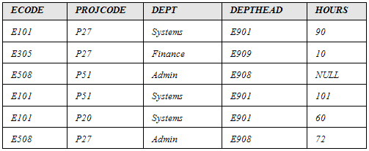
Second Normal Form
A table is said to be in 2NF when:
It is in the 1NF, and
No partial dependency exists between non-key attributes and key attributes.
The guidelines for converting a table into 2NF are:
Find and remove attributes that are functionally dependent on only a
part of the key and not on the whole key. Place them in a different table.
Group the remaining attributes.
The preceding table could lead to the following problems
Insertion
Updation
Deletion
The department of an employee cannot be recorded until the employee is assigned a project.
For an employee, ECODE, DEPT, and DEPTHEAD are repeated. Any change will have to be recorded in every row of the EMPLOYEE table.
When the project finishes, the employee details are deleted. This leads to loss in information about the department to which employee belongs.

Slide 9
DEPTHEAD is functionally dependent on ECODE; however, it is not dependent on the attribute, PROJCODE.
Dept is functionally dependent on part of the key, which is ECODE.
Composite Key

Slide 10
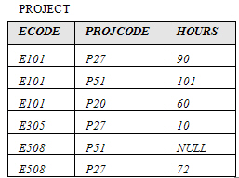
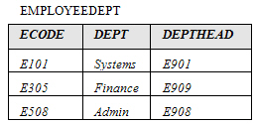
To convert the PROJECT table into 2NF, we must remove the attributes that are not functionally dependent on the whole key.
We should place the removed attributes in a different table along with the attribute they are functionally dependent on

Slide 11
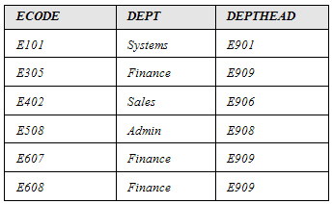
Third Normal Form
A relation is said to be in the 3NF if and only if:
It is in 2NF, and
No transitive (indirect) dependency exists between non-key attributes and key attributes.
The guidelines for converting a table into 3NF are:
Find and remove non-key attributes that are functionally dependent on attributes that are not the primary key. Place them in a different table.
Group the remaining attributes.
The preceding table could lead to the following problems:
Insertion
Updation
Deletion
The department head of a new department that does not have any employees at present cannot be entered in the DEPTHEAD column.
For a department, DEPTHEAD is repeated. Any change will have to be made consistently across the table.
If an employee record is deleted, the information about DEPTHEAD will also be deleted.

Slide 12
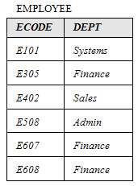
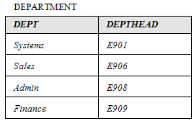
DEPTHEAD is functionally dependent on DEPT, which is not a primary key.
Primary key
To convert the EMPLOYEE table into 3NF, you must remove the DEPTHEAD column and place it in another table

Slide 13
Boyce Codd normal form
BCNF is the advance version of 3NF. It is stricter than 3NF.
A table is in BCNF if every functional dependency X → Y, X is the super key of the table.
For BCNF, the table should be in 3NF, and for every FD, LHS is super key.
The original definition of 3NF was not sufficient in some situations. It was not satisfactory for the tables:
That had multiple candidate keys.
Where the multiple candidate keys were composite.
Where the multiple candidate keys overlapped (had at least one attribute in common).
The guidelines for converting a table into BCNF are:
Find and remove the overlapping candidate keys. Place the part of the candidate key and the attribute it is functionally dependent on, in a different table.
Group the remaining items into a table.

Slide 14
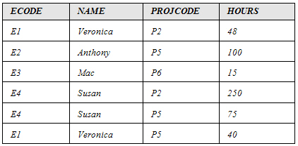
PROJECT table is already in 3NF
Primary Key
The following points describe the functional dependencies in the PROJECT table:
HOURS is functionally dependent on ECODE+PROJCODE.
HOURS is also functionally dependent on NAME+PROJCODE.
NAME is functionally dependent on ECODE.
ECODE is functionally dependent on NAME.
You will notice that the PROJECT table has:
Multiple candidate keys that are ECODE+PROJCODE and NAME+PROJCODE.
Composite candidate keys.
Candidate keys that overlap since the PROJCODE attribute is common between the two candidate keys.
The only non-key item is HOURS, which is dependent on the whole key, ECODE+PROJCODE or NAME+PROJCODE.
ECODE and NAME are determinants since they are functionally dependent on each other.
As per BCNF, the determinants have to be candidate keys.
You can remove NAME and ECODE and place them in a different table.
NAME+PROJCODE can also be chosen as the primary key and hence, is a candidate key.

Slide 15
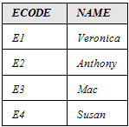
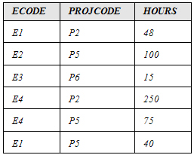
You can remove NAME and ECODE and place them in a different table.

Slide 16
Thank You

